Slide 1
Employee Data Analysis using Excel
STUDENT NAME: P.Nandhini
REGISTER NO:312218625
DEPARTMENT:B.Com
COLLEGE: J.N.N Arts and women's college

Slide 2
PROJECT TITLE
Employee Performance Analysis using Excel

Slide 3


AGENDA
Problem Statement
Project Overview
End Users
Our Solution and Proposition
Dataset Description
Modelling Approach
Results and Discussion
Conclusion
3/21/2024 Annual Review

Slide 4

PROBLEM STATEMENT
A problem statement is a clear and concise description of a problem or issue that needs to be addressed. It typically includes: 1. Problem identification 2. Context 3. Goals and objectives 4. Key stakeholders 5. Constraints Here's a template: *Problem Statement Template:* "Currently, [briefly describe the problem]. This is causing [specific issue/consequence]. The goal is to [desired outcome]. Key stakeholders include [list]. The solution should [constraints/requirements]." Example: "Currently, our customer support team receives a high volume of calls, resulting in long wait times and decreased customer satisfaction. The goal is to reduce wait times by 30% within the next 6 months. Key stakeholders include customers, support agents, and management. The solution should integrate with our existing CRM system." Please provide the context or topic, and I'll help craft a problem statement.

Slide 5

PROJECT OVERVIEW
A project overview provides a brief summary of the project's key aspects. Here's a template: *Project Overview Template:* 1. Project Title: [Insert title] 2. Project Objective: [Clearly state the main goal] 3. Background/Context: [Provide relevant history, context, or problem statement] 4. Scope: [Define what's included and excluded] 5. Key Deliverables: [List main outputs or outcomes] 6. Timeline: [Include start/end dates, milestones, and deadlines] 7. Stakeholders: [Identify key individuals/organizations] 8. Budget: [Provide budget information, if applicable] *Example Project Overview:* *Project Title:* Development of E-commerce Website *Project Objective:* Create a user-friendly e-commerce website to increase online sales by 25% within 6 months. *Background/Context:* Our company aims to expand its online presence. *Scope:* Website design, development, testing, and deployment. *Key Deliverables:* - Functional website with payment gateway - Product catalog integration - Mobile respons
.

Slide 6

WHO ARE THE END USERS?
End users are individuals or organizations that directly interact with a product, system, or service to achieve their goals or satisfy their needs. Examples of end users: *Individuals:* 1. Consumers (e.g., shoppers, gamers) 2. Students (e.g., using educational software) 3. Patients (e.g., using medical devices) 4. Employees (e.g., using company software) *Organizations:* 1. Businesses (e.g., using CRM systems) 2. Governments (e.g., using data analytics tools) 3. Non-profits (e.g., using fundraising platforms) 4. Healthcare providers (e.g., using medical records systems) *Specific examples:* 1. E-commerce website: Customers buying products online 2. Mobile app: Smartphone users downloading and using the app 3. Software: Companies using productivity tools (e.g., Microsoft Office) 4. Medical device: Healthcare professionals and patients using the device To identify end users, consider: 1. Who benefits from the product/service? 2. Who interacts with the product/service directly? 3. What are their needs, goals, and pain points? Understanding end users is crucial for: 1. Designing user-centered products/services 2. Developing effective marketing strategies 3. Providing excellent customer support 4. Improving user experience and satisfaction Who are the end users for your project?

Slide 7

OUR SOLUTION AND ITS VALUE PROPOSITION
Here's a template to describe your solution and its value propositions: *Solution Name:* [Insert solution name] *Description:* [Briefly describe your solution] *Value Propositions:* *Primary Benefits:* 1. 2. 3. *Key Features:* 1. 2. 3. *Value to End Users:* 1. 2. 3. *Competitive Advantage:* [What sets your solution apart from others] *Example:* *Solution Name:* SmartTask *Description:* AI-powered project management tool for teams. *Value Propositions:* *Primary Benefits:* 1. *Increased Productivity*: Automate tasks, streamline workflows. 2. *Enhanced Collaboration*: Real-time updates, seamless communication. 3. *Data-Driven Insights*: Analyze project performance, optimize decision-making. *Key Features:* 1. Task automation 2. Real-time reporting 3. Integrations with popular tools *Value to End Users:* 1. Reduced project timelines 2. Improved team efficiency 3. Informed decision-making *Competitive Advantage:* AI-driven task suggestions, intuitive interface. Please fill in the template with your solution details. Some questions to consider: 1. What problem does your solution solve? 2. How does your solution benefit end users? 3. What unique features set your solution apart? 4. How does your solution improve existing processes or workflows? 5. What are the key pain points your solution addresses?

Slide 8
Dataset Description
Provide information about your dataset, and I'll help create a comprehensive description. Please provide the following details: 1. Dataset name 2. Brief description (1-2 sentences) 3. Dataset type (public/private, structured/semi-structured/unstructured) 4. Data format (CSV, JSON, Excel, etc.) 5. Number of records/rows 6. File size (MB/GB) 7. Variables/attributes (list names and data types) 8. Target variable (if applicable, for prediction/modeling) 9. Data collection source/method 10. Time period/date range 11. Geographic location (if applicable) 12. Missing values/noisy data handling 13. Data validation methods 14. Intended use 15. License/usage rights Or provide answers to these questions: 1. What problem does your dataset aim to solve? 2. What insights can be gained from your dataset? 3. Who is the target audience? 4. How was the data collected? 5. Are there any specific features or variables? I'll help organize this information into a clear and concise dataset description. Format: *Dataset Name* *Description* *Dataset Characteristics* - Type: - Format: - Size: - Number of records: *Data Features* - Variables: - Attributes: - Target Variable: *Data Collection* - Source: - Method: - Time Period: - Location: *Data Quality* - Missing Values: - Noisy Data: - Validation: *Usage* - Intended Use: - License: Let's get started!

Slide 9

THE "WOW" IN OUR SOLUTION
The "WOW" factors in your solution are the unique, innovative, and impressive aspects that set it apart from others. Please provide more details about your solution, and I'll help identify the WOW factors: 1. What problem does your solution solve? 2. What makes your solution unique? 3. What are the key features and benefits? 4. How does it improve existing solutions? 5. Are there any innovative technologies or approaches used? Some examples of WOW factors: 1. AI-powered automation 2. Real-time data analytics 3. Personalized user experiences 4. Scalable and secure architecture 5. Integration with emerging technologies (AR/VR, IoT, etc.) 6. User-friendly interface 7. Cost-effective solution 8. Faster processing times 9. Advanced security features 10. Collaborative tools Format: *WOW Factors:* 1. *[Factor 1]*: [Brief description] 2. *[Factor 2]*: [Brief description] 3. *[Factor 3]*: [Brief description] *Example:* *WOW Factors:* 1. *AI-Driven Insights*: Our solution uses machine learning algorithms to provide actionable recommendations. 2. *Real-Time Collaboration*: Seamless teamwork and communication through our intuitive platform. 3. *Automated Workflow*: Streamline processes with our automated task management system. Let's highlight the WOW in your solution!
3/21/2024 Annual Review
9

Slide 10
MODELLING
Modelling refers to the process of creating a representation or simulation of a real-world system, concept, or scenario to analyze, predict, or optimize its behavior. equations, algorithms) 2. Statistical modelling (regression, probability) 3. Computational modelling (simulations, machine learning) 4. Visual modelling (diagrams, graphs, infographics) 5. Conceptual modelling (frameworks, architectures) Modelling applications: 1. Predictive analytics 2. Decision support systems 3. Optimization 4. Risk analysis 5. Scenario planning 6. Data visualization 7. Scientific research 8. Engineering design 9. Business strategy 10. Policy development Modelling techniques: 1. Linear regression 2. Decision trees 3. Neural networks 4. Monte Carlo simulations 5. Dynamic systems modelling 6. Agent-based modelling 7. System dynamics 8. Bayesian networks 9. Time series analysis 10. Machine learning algorithms Please specify: 1. What type of modelling are you interested in? 2. What problem or system do you want to model? 3. What are your goals (prediction, optimization, analysis)? 4. What data or information do you have available? I'll assist with: 1. Model selection 2. Model development 3. Model evaluation 4. Interpretation of results 5. Model refinement Let's get started with modelling!
10

Slide 11
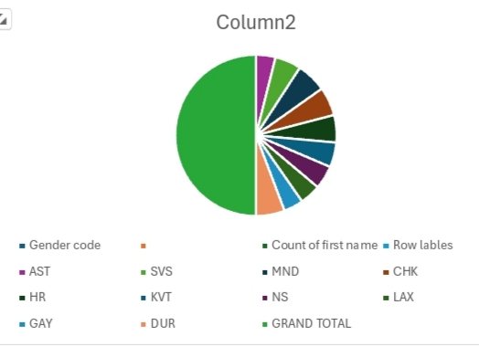
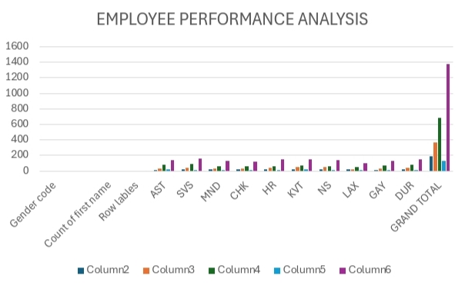
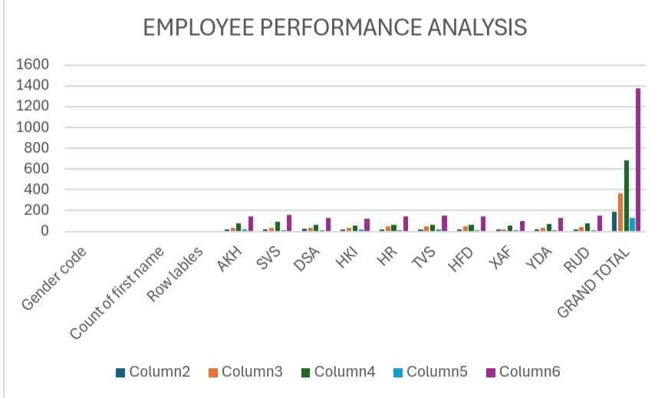
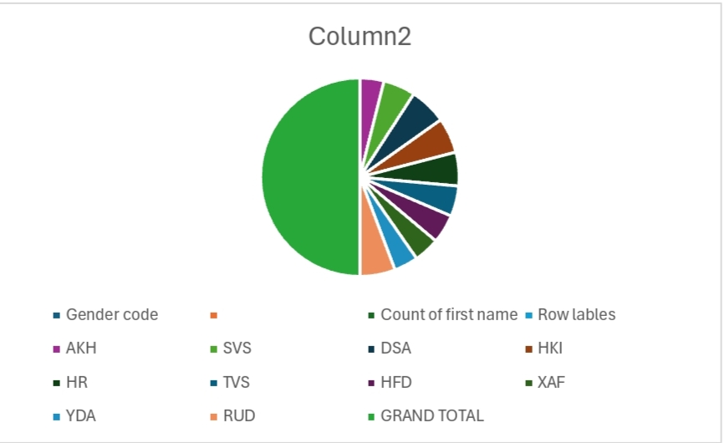
RESULTS
11

Slide 12
conclusion
Conclusion To wrap up your project: *Project Title:* [Insert project title] *Summary:* [Briefly summarize the project, highlighting key objectives, methodologies, and outcomes] *Key Findings:* 1. [Main discovery 1] 2. [Main discovery 2] 3. [Main discovery 3] *Implications and Recommendations:* [Discuss the significance and potential applications of your findings, and provide actionable suggestions] *Limitations and Future Work:* [Acknowledge constraints, suggest areas for improvement, and outline potential future research directions] *Final Thoughts:* [Offer concluding remarks, highlighting the project's value and potential impact] *Next Steps:* [Outline concrete actions to build upon the
A conclusion is the final piece of writing in a research paper, essay, or article that summarizes the entire work. The conclusion paragraph should restate your thesis, summarize the key supporting ideas you discussed throughout the work, and offer your final impression on the central idea.

